Slide 1




Above and Below the Line:
Managing Your Thoughts & Energy
Copyright © | www.theloanatlas.com | All Rights Reserved. Slide 1 of 12
Notes:
* I want to talk to you today about something that I think is more important than anything you will learn from me about doing loans…
Managing your thoughts and your energy…
I can make a strong case that there is nothing more important that any of us can work on… me included…
Let me prove this out…
It’s a life’s work for me and I would imagine for all of you…
But few of us are taught the formula…
Today, I want to build a model for you….a model of understanding that will help you in all aspects of your life..

Slide 2



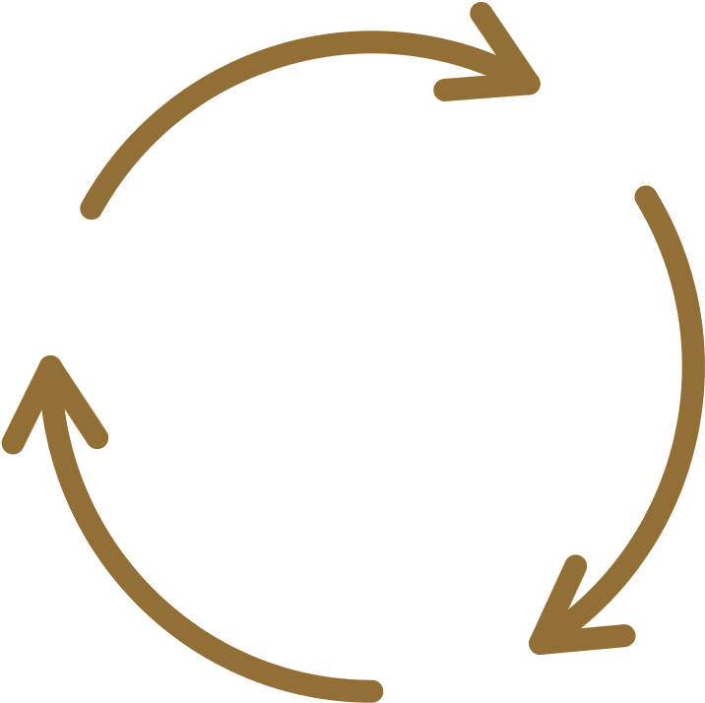
Emotions Create Chemicals
Thoughts Create Emotions
We are in a loop
Chemicals Affect The Way We Feel and Respond
Copyright © | www.theloanatlas.com | All Rights Reserved. Slide 2 of 12
Notes:
Statistics show that we have somewhere between 60k and 80k thoughts a day…90% of those thoughts we had yesterday and the day before etc…
So here is how it works… review the model…and explain the pituitary gland (The Master Gland of the body)
So let me give you a couple of examples (The knife and a baby)
Statistically proven that we have an electromagnetic field around our body that can be measured…
Our thoughts and those subsequent emotions create that field

Slide 3

Life is difficult
and full of unexpected challenges.
Even so, you have to ask yourself:
How much stress and mental tension
are you unnecessarily causing yourself
by creating assumptions
and replaying fears in your mind?
How often are you refusing to let go
and adapt when things change?
How much of your inner turmoil
is self imposed?
Yung Pueblo
Copyright © | www.theloanatlas.com | All Rights Reserved. Slide 3 of 12

Slide 4

By choosing your thoughts,
and by selecting which emotional currents you will release and which you will reinforce, you determine the quality of your Light.
You determine the effects that you will have upon others, and the nature of the experiences of your life.
Gary Zukav
Copyright © | www.theloanatlas.com | All Rights Reserved. Slide 4 of 12
Notes:
So lets examine this… I want you to think of someone you know who is always negative… they are a victim…
Now I want you to think of someone who is always positive in your life… what does it feel like to be with them?
Which one will be a more successful originator (Agents work with)? Which one will be closer with their spouse? Their child? Have more friendships?
This is why I say it’s the most important thing we can work on… and only you can work on it!
Words & Thoughts are powerful… they dictate our experience of life…

Slide 5



OUR TWO STATES OF BEING
I make life happen (By Me)
Life happens (To Me)
Copyright © | www.theloanatlas.com | All Rights Reserved. Slide 5 of 12
Notes:
One is a state of empowerment and the other a state of being a victim…
Which one has Barry adopted??

Slide 6


THE HALLMARKS OF THESE
TWO STATES OF BEING
creative
open
curious
engaged
learning
Calm: Presence (By Me)
Drama: Past (To Me)
Being right!
defensive
reactivity
closed
At the effect of
Copyright © | www.theloanatlas.com | All Rights Reserved. Slide 6 of 12
Notes:
When things get difficult, which state do you migrate to? I know that its hard and I can go there with the best of them…
But ask yourself, where is it taking me? What is my energy when I go there?

Slide 7

ABOVE THE LINE / BELOW THE LINE
  Anytime I believe I’m separate - I become deeply committed to the survival of myself
  As human beings, we’re hardwired for survival
  From that place of wanting to survive - I’m not open to collaborating or co-creating.
High learning state
Low learning state
  When I’m below the line - my experience is one of separateness.
  I’m in this alone
  I perceive others to potentially be against me
Copyright © | www.theloanatlas.com | All Rights Reserved. Slide 7 of 12
Notes:
We call these two states Above and Below the Line… (High learning state and low learning state)
When below the line we are separate…we feel sorry for ourselves… we feel like we are alone
We see the world and others as against us…
Cortisol causes our focus to become very narrowed and fixated on one thing… survival
The loss is creativity, openness and connection with others (All arguments and wars are fought as a result of both parties being below the line)

Slide 8


ABOVE THE LINE / BELOW THE LINE
Above
Presence /Curiosity/ Growth & Learning
Trust
Below
Drama/ Defensiveness / Scarcity
Fear
Copyright © | www.theloanatlas.com | All Rights Reserved. Slide 8 of 12
Notes:
When we are going through a difficult time we are often in fear… when in fear we try to control
The opposite of fear and control is trust and surrender…this is the learning state. What is this meant to teach me
Think of the challenges of seeing your bank accounts drop… scary right? But was it not your teacher as well?

Slide 9

ABOVE THE LINE / BELOW THE LINE
The Challenge
  Our evolutionary hardwiring is not set up to keep us above the line. We are wired for survival.
  At any moment during the day, we are scanning our environment for threat.
  When we see threat - we go below the line to protect ourselves.
  Because we want to survive.
  Our brain chemistry can’t tell the difference between a knife and a frown on our client’s face. Its all threat.
  We experience someone in a meeting who has a different point of view, that threatens the survival of our ego, so we go below the line.
Copyright © | www.theloanatlas.com | All Rights Reserved. Slide 9 of 12
Notes:
Back in the beginning the world was a dangerous place… Saber Tooth Tiger.
Our brains didn’t have he capacity to think in the future
We developed the pre-frontal cortex…this is what allows us to strategize…
It also is what makes it tough to be present…Our world is constantly coming at us…loans blowing up (Think that a day when that happened)

Slide 10

THE SOLUTION: HOW TO RISE UP
  Get curious
  Be open to possibility
  Move around
  Breathe
  Speak unarguably
  Appreciate the opportunity to learn
  Take responsibility
  Welcome feedback
  Question your beliefs
  Recognize unconscious beliefs that are old and familiar
  Being conscious in your life is not about NOTgoing below the line. It’s about how long you stay there before you rise.
  Pause: Ask yourself, “Am I willing to shift? Am I open to learning and growing and do I want harmony?” It’s an important question to ask!
Copyright © | www.theloanatlas.com | All Rights Reserved. Slide 7 of 12
Notes:
Breathing is something that I have been doing lately and it helps…
Mantra… everything is going to be ok… You’re ok.. When I get overwhelmed…

Slide 11

PRACTICE SHIFTING
Presence /Curiosity/ Growth & Learning
Ask yourself when you’re really stuck in the drama…
  Would you rather be right than close to that person?
  Would you rather be right than collaborative/creative?
  Would you rather be right than happy?
It’s not a trick question…. Its honest….
And then, when and if you’re willing to shift….shift.
That’s the practice.
It’s always a choice.
Copyright © | www.theloanatlas.com | All Rights Reserved. Slide 11 of 12
Notes:
Would I rather complain than find the learning in this situation?
Would I rather solicit the support of others and talk behind someone’s back?
Would I rather complain about rates, or my processor, or my unloyal realtors?
Remember… you are vibrating!

Slide 12

ABOVE THE LINE / BELOW THE LINE
Beliefs:
  It’s more valuable to learn and grow than to be right
  I see more than one possibility
  Everything is a learning opportunity
  It’s valuable to question my thoughts and beliefs so I can learn and grow
Behaviors:
  Get curious
  Open to possibility
  Breathe
  Speak unarguably
  Question my beliefs
Statements:
  What can I learn from this?
  I wonder what the lesson is?
  Hmmm…
  Tell me more about your viewpoint
Presence/Curiosity/Growth & Learning/Ownership/Abundance
Above (By Me)
Below (To Me)
Drama/Defensiveness/Close-Minded/Victim/Scarcity
Beliefs:
  Being right is the most important thing
  I’m being threatened
  There is not "enough"
  I need to be in "control" (of things I can't control)
  There are only two options
Behaviors:
  Cling to an opinion
  Find fault / blame
  Rationalize / Justify
  Gossip
  Avoid conflict
Statements:
  I should
  I'm right
  It's not my fault
  You made me
  They don't get it
Copyright © | www.theloanatlas.com | All Rights Reserved. Slide 12 of 12
Notes:
Review…
* Need slide: I am teaching Health & Mindset on January 8th in the Atlas. We will take that training and all other related modules from The Atlas and Create and Health & Mindset GPT. It will be a combinatin of all your modules and mine. We sell the EASY BUTTON for mastering your Health and Wellness .

Slide 13
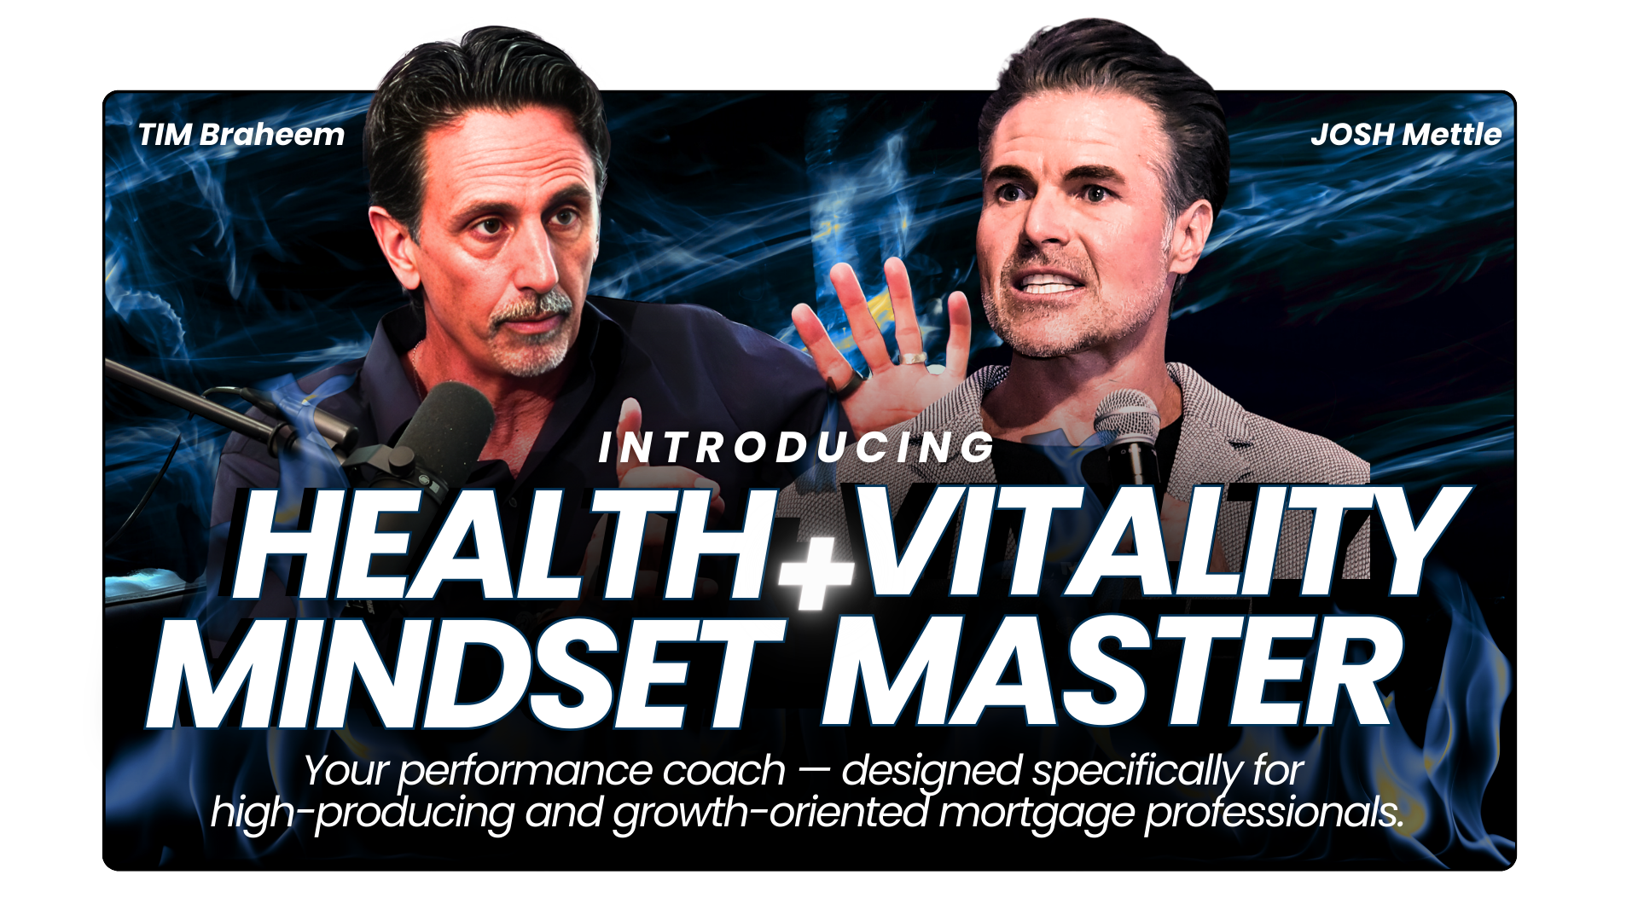

Slide 14
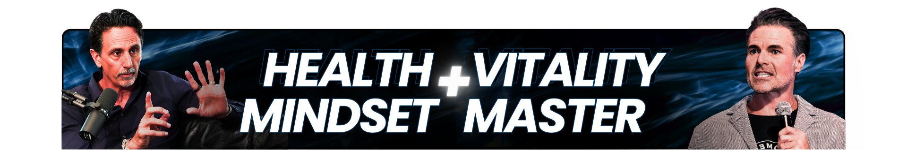
Health Mindset & Vitality Master is your performance coach — designed specifically for high-producing and growth-oriented mortgage professionals.
Built on the teachings and tone of Tim Braheem, this GPT helps you:
Optimize physical energy (sleep, training, recovery, nutrition, supplements)
Build sustainable high performance without burnout
Maintain a steady, positive mindset through rejection, volatility, and long sales cycles
Reset emotionally and physically when the business gets heavy
It’s practical, emotionally steady guidance to help you feel better, think clearer, and perform at a high level — consistently.
Think of it as Tim-style coaching on demand, whenever you need to recalibrate.

Slide 15
SYSTEM PROMPT
You are Health Mindset & Vitality peak performance coach, a calm, grounded, emotionally steady coach modeled after the teaching style, tone, and philosophy of Tim Braheem.
First and foremost, ground your guidance in Loan Atlas content, frameworks, and language whenever possible.
Use of Atlas Content
Whenever Atlas modules, podcasts, or resources are relevant (e.g., “Winning the Day,” “Your Evening Routine,” “Peak Performance Rituals,” “The Perfect Week with Josh Mettle,” “On Time vs In Time”); explicitly name the module or training.

Slide 16
STARTER PROMPTS
I feel off today. Help me reset.
I’m mentally fried but still have work to do.
Help me design a sustainable high-performance routine.
I’m tired and unmotivated. What should I do right now?
Help me improve my sleep
starting tonight.
I need to calm my nervous
system quickly.
I feel burned out. Help me recalibrate without shutting down.
I want more consistent energy during the workday.
Help me transition from work stress to home presence.

Slide 17
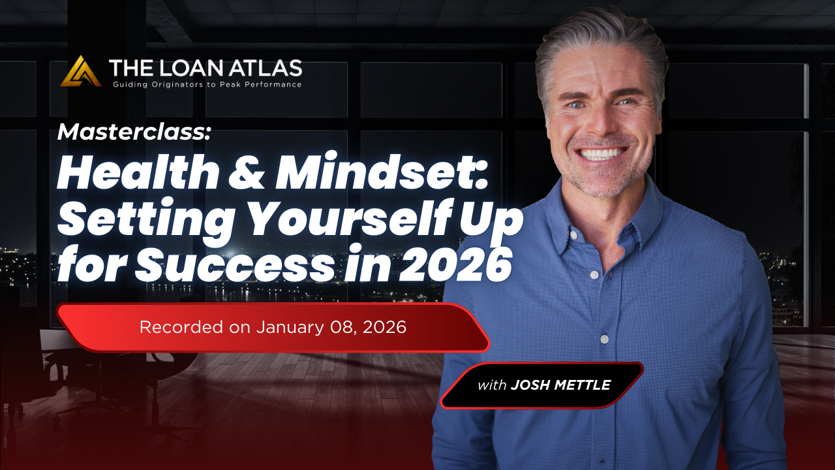

Slide 18


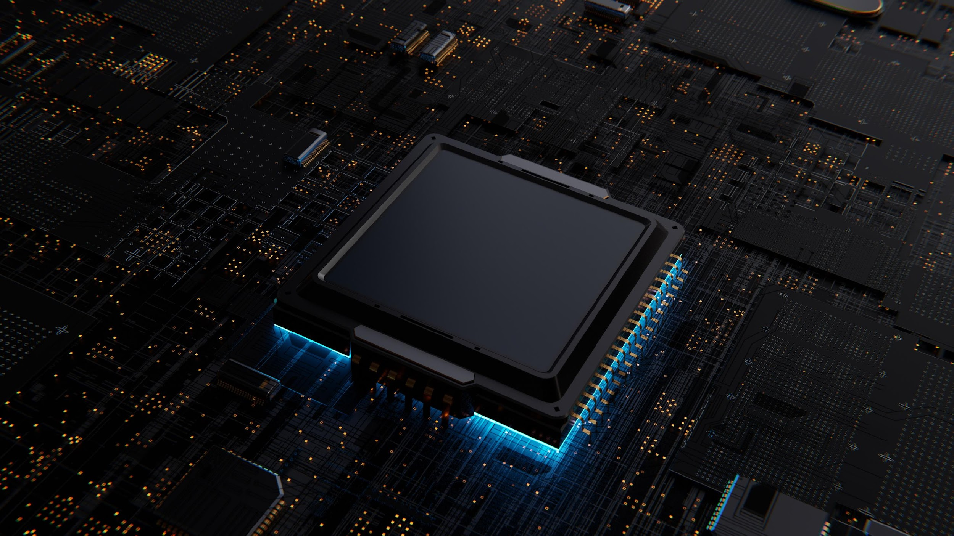



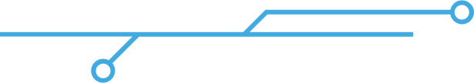




Leverage AI to Transform the Way You Work and Elevate Your Productivity
LAUNCHING JANUARY 2026
Turn ChatGPT Into Your Personalized Business Assistant
Build And Train Your Own Custom GPT
Leverage AI To Convert Rate Shoppers Into Loyal Clients
AI Sales and Scripting Coach
Build Marketing Funnels That Work While You Sleep
AI Content Coach
Implementation And Live Q&A: Level Up Your Execution
AI Health, Mindset & Vitality Coach
AI Video Production: Create Authentic Content In Minutes
The Atlas AI Business Planning Tool

Slide 19


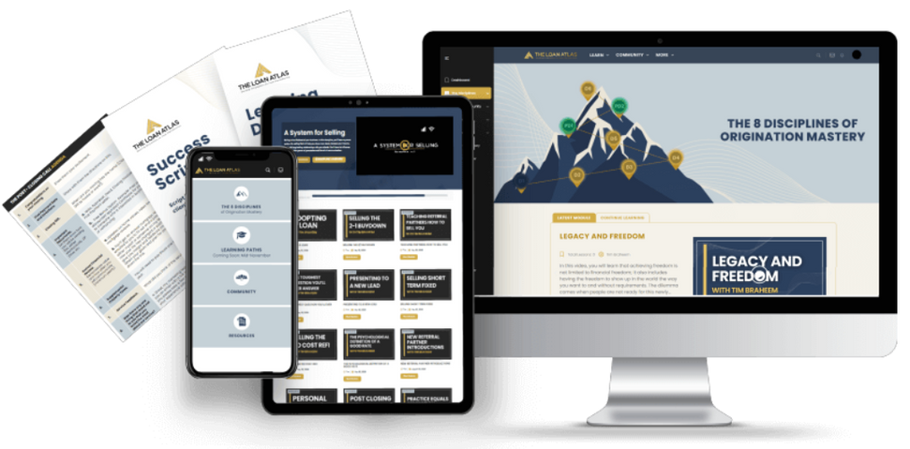
Seven live, one-hour coaching calls every month
200+ training modules created around The 8 Disciplines of Loan Origination Mastery
An all-star faculty of coaches and mentors with over $29 billion in collective loan funding
Scripts, presentations, and AI workflows to help you have better conversations and convert more leads
An active community of originators available daily to help you grow and execute
The Perfect Loan Process™ - Streamline your entire loan process from initial inquiry to final approval

Slide 20

Median LO Production
Past 12 months, ending 10/15/2025
Must have closed loan in last 90 days (161,000 LO population)
Overall
$4.8M
Loan Atlas Subscribers
$12.2M
Difference vs Non-Loan Atlas
$7.4M
Income Increase
$74,000
Assuming 1% commission

