Slide 1


The ‘Easy’ Button
For 2026 Business Planning
“If you fail to plan,
you plan to fail.”
- Anonymous
Notes:
Ask: Ever been to an event where you took notes but never implemented? (Raise hands)
Ask: Ever started implementing a plan but quit because it was overwhelming? (Raise hands)
Common problem: not knowing scope or where to start → defeat.
Key: Doing what you say builds trust with self and others.
Remind them of the need to create the right environment and ON TIME
If your business plan is to prospect for 90 minutes did you set up your vm and auto reply to inform people? This is what I am talking about with environment
Are you reacting or taking charge…
Reflection: Are you someone who follows through, or not?
Set hook in the beginning that there is an easy button…
I am sharing what I have learned and implemented and have watched top originators do the last twenty years…We did this in Loan Toolbox, we do it with Loan Atlas and my L360 clients have been doing it for years. It works Team.
What it takes to be successful: A plan, Crazy discipline & Focus, creating the right environment (On time)… this will get you to 100 million…
Like Josh Mettle 675 million as a team (Best year) and about 250 million this year…
The difference is that they know how to create a plan and stay on course…
I’m gonna walk you through all of the specifics and then I will give you the easy button at the end… Stay present with me… You need to understand the importance of this…before I give you the easy path to your success.

Slide 2

The Challenge with Business Planning
“The best way to predict the future is to create it.”
- Peter Drucker
Overly complex processes
Lack of clarity
Overcommitting
No accountability
Poor environment
Notes:
Mention team misalignment and shiny object chasing.
Principle: Momentum is everything, built with small victories.

Slide 3

Evaluation Before Planning
“Quality is never an accident.
It is always the result of intelligent effort.”
John Ruskin
Notes:
Evaluation first → where best to allocate focus.
Start “50,000 feet” then move to runway.
How are you assessing yourself and where your time should be focused? Its critical that you do this otherwise you may be focused on the wrong things…
Why we begin with Knowing Your Numbers.

Slide 4
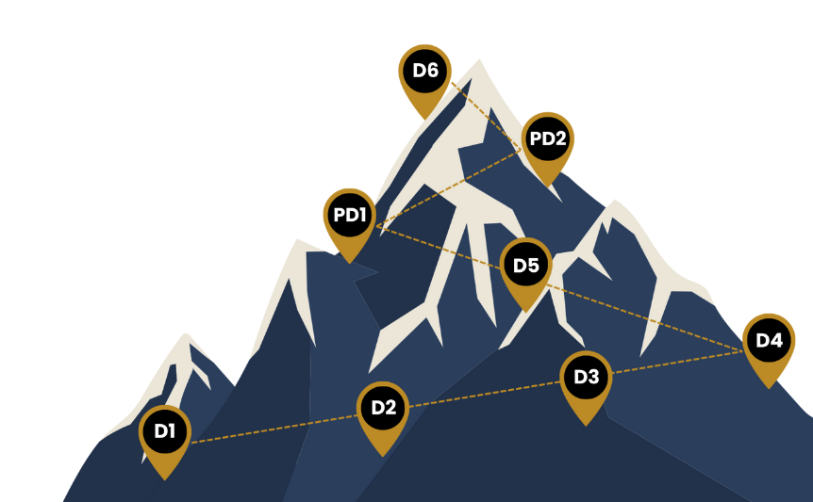
Discipline Areas Overview
The Eight Disciplines of Origination Mastery
Essential Knowledge
Systems of Selling
Marketing Mastery
Team & Leadership Excellence
Systems of Service
Time & Task Management
Mindset & Health
Legacy & Freedom

Slide 5
Essential Knowledge
Mastery of Artificial Intelligence
Underwriting Guidelines
Loan Programs (DSCR, Non-QM, Reverse)
Financial Markets (CMA, Highway)
Notes:
Technical mastery builds confidence + trust.
Ask: Are you ready for the direction that this industry is headed? Do you have knowledge of a full arsenal of products to sell? Are you using AI to take your business to the next level?

Slide 6
Systems of Selling
Presentations to Borrowers
Presentations to Realtors
Presentations to CPAs, CFPs & Attorneys
One-to-many Presentations
You must have a high batting average
Notes:
Sales = structured conversations = higher conversion
Highlight efficiency of “one-to-many.”

Slide 7
Marketing Mastery
Database Marketing
Marketing to Referral Sources
Consumer Direct Marketing & Social Media
Notes:
Ask: Which of these is your strongest channel?

Slide 8
Team & Leadership Excellence
Building a Team
Hiring & Onboarding
Training & One-on-Ones
Culture
Leading in your own life with integrity
Notes:
Leadership creates leverage and scalability
Culture determines sustainability and freedom

Slide 9
Systems of Service
The Perfect Loan Process (A system for dynamic service)
Under-promise and over-deliver
Using AI to create systems to streamline your workday
Notes:
Excellence → trust + referrals.
Ask: What would your future look like if every loan you did was A+?

Slide 10
Time & Task Management
Organizing Day & Calendar
Task Management
Strategic Planning
Email & Tech Efficiency
Life Balance
Notes:
Time management = performance multiplier.
Ask: Where do you lose the most time?

Slide 11
Mindset & Health
Energy Management
Morning & Evening Routines
Mental & Emotional Health
Overcoming your limiting beliefs
Nutrition, Exercise & Physical Health
Notes:
Inner state drives outer results.
Ask: What are the mental hurdles that you need to overcome? That trip you up? That create a self-defeating prophecy in your business and life?

Slide 12
Legacy & Freedom
Investing & Diversification
Annuity Income Streams
Legacy Planning
Setting up your future
Notes:
Business funds freedom…
Ask: What’s your long-term vision? Where are you going and is it by design?

Slide 13
Reflection Exercise
Write one BUSINESS area to improve.
Write one PERSONAL area to improve.

Slide 14
Writing Strong Goals
SMART Goals
SMART Example
Specific
Measurable
Achievable
Relevant
Time-bound
STUPID: Get more Realtor business.
SMART: Design and implement a plan that has me procuring three new Realtor partners that provide me with no less than five closed loans each in 2026 so that I can increase my income by $80,000.
DEFINITION: Goals are broad statements of what your company or you individually want to achieve in the long run in each Discipline.
Notes:
Define goals as broad achievement areas.
Prompt: Write 3 SMART goals as soon as this call is over…

Slide 15
The Importance of Action Items
Action Items = Habits
DEFINITION: Specific, granular steps with frequency, time, and location. Action items are the specific granular steps that need to be implemented or completed for a goal to be fulfilled.
Schedule a half day in my office by March 30th 15, 2026, from 8:30 a.m. to 12:30 p.m. to conduct market research on the top 40 agents in my target market who have listings aged 45 days or more.
Spend a half day in my home office by April 3rd, 2026, from 1:00 p.m. to 5:00 p.m. developing an approach script and presentation that adds value to my target agents.
Call my target agents every Monday morning at 9:00 a.m. from my office, and share my presentation on how I can help them move their inventory.
Notes:
Action items are what make SMART goals real.

Slide 16
Homework
Homework Checklist:
Finalize 3 business goals for 2026 (with “so that” outcomes)
Develop action items (frequency, time, location)
Block a minimum of 6 hours a month of uninterrupted time at an off-site location for the entire year NOW.
Notes:
Reinforce accountability.
Stress importance of outcome-based “so that” phrasing.

Slide 17
Free Gifts
The slide deck from this presentation
Goal Creation Document (3 SMART goals + action items)
Notes:
Emphasize the tools save time and increase execution.
Invite participants to explore each resource.
Demo the tool

Slide 18

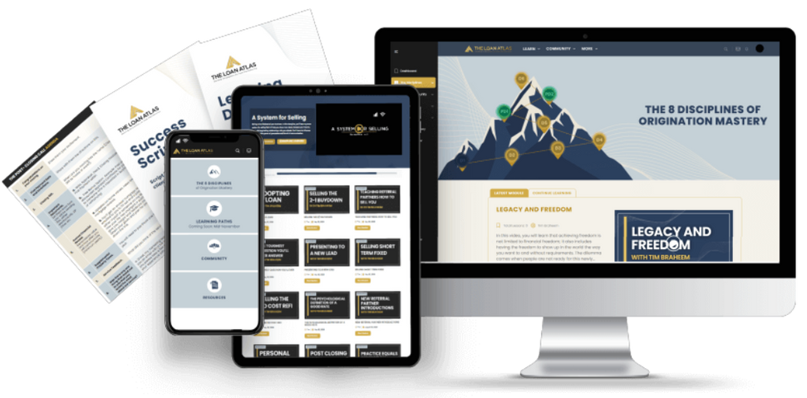

Seven live, one-hour coaching calls every month
200+ training modules created around The 8 Disciplines of Loan Origination Mastery
An all-star faculty of coaches and mentors with over $29 billion in collective loan funding
Scripts, presentations, and AI workflows to help you have better conversations and convert more leads
An active community of originators available daily to help you grow and execute
PLUS full access to the Atlas AI Business & Life Planner
The Perfect Loan Process™ - Streamline your entire loan process from initial inquiry to final approval

Slide 19


Slide 20











Leverage AI to Transform the Way You Work and Elevate Your Productivity
JUST LAUNCHED
Turn ChatGPT Into Your Personalized Business Assistant
Build And Train Your Own Custom GPT
Leverage AI To Convert Rate Shoppers Into Loyal Clients
AI Sales and Scripting Coach
Build Marketing Funnels That Work While You Sleep
Implementation And Live Q&A: Level Up Your Execution
AI Health, Mindset & Vitality Coach
AI Video Production: Create Authentic Content In Minutes
The Atlas AI Business Planning Tool

Slide 21

Median LO Production
Past 12 months, ending 10/15/2025
Must have closed loan in last 90 days (161,000 LO population)
Overall
$4.8M
Loan Atlas Subscribers
$12.2M
Difference vs Non-Loan Atlas
$7.4M
Income Increase
$74,000
Assuming 1% commission

Slide 22


